Slide 1
P0 Presentation
Christian Romero

Slide 2
Design
Db 3rd Normal Form
EF Core w/ Db Approach
Locations have an inventory
“Solution Design”
Domain classes
Db Access library
BusLogic project
Interfaces for helper classes
persistent data (to a DB); no hardcoding of data.(prices, customers, order history, etc.)
XML comments
Inventory decrementation
10 Unit testing methods

Slide 3
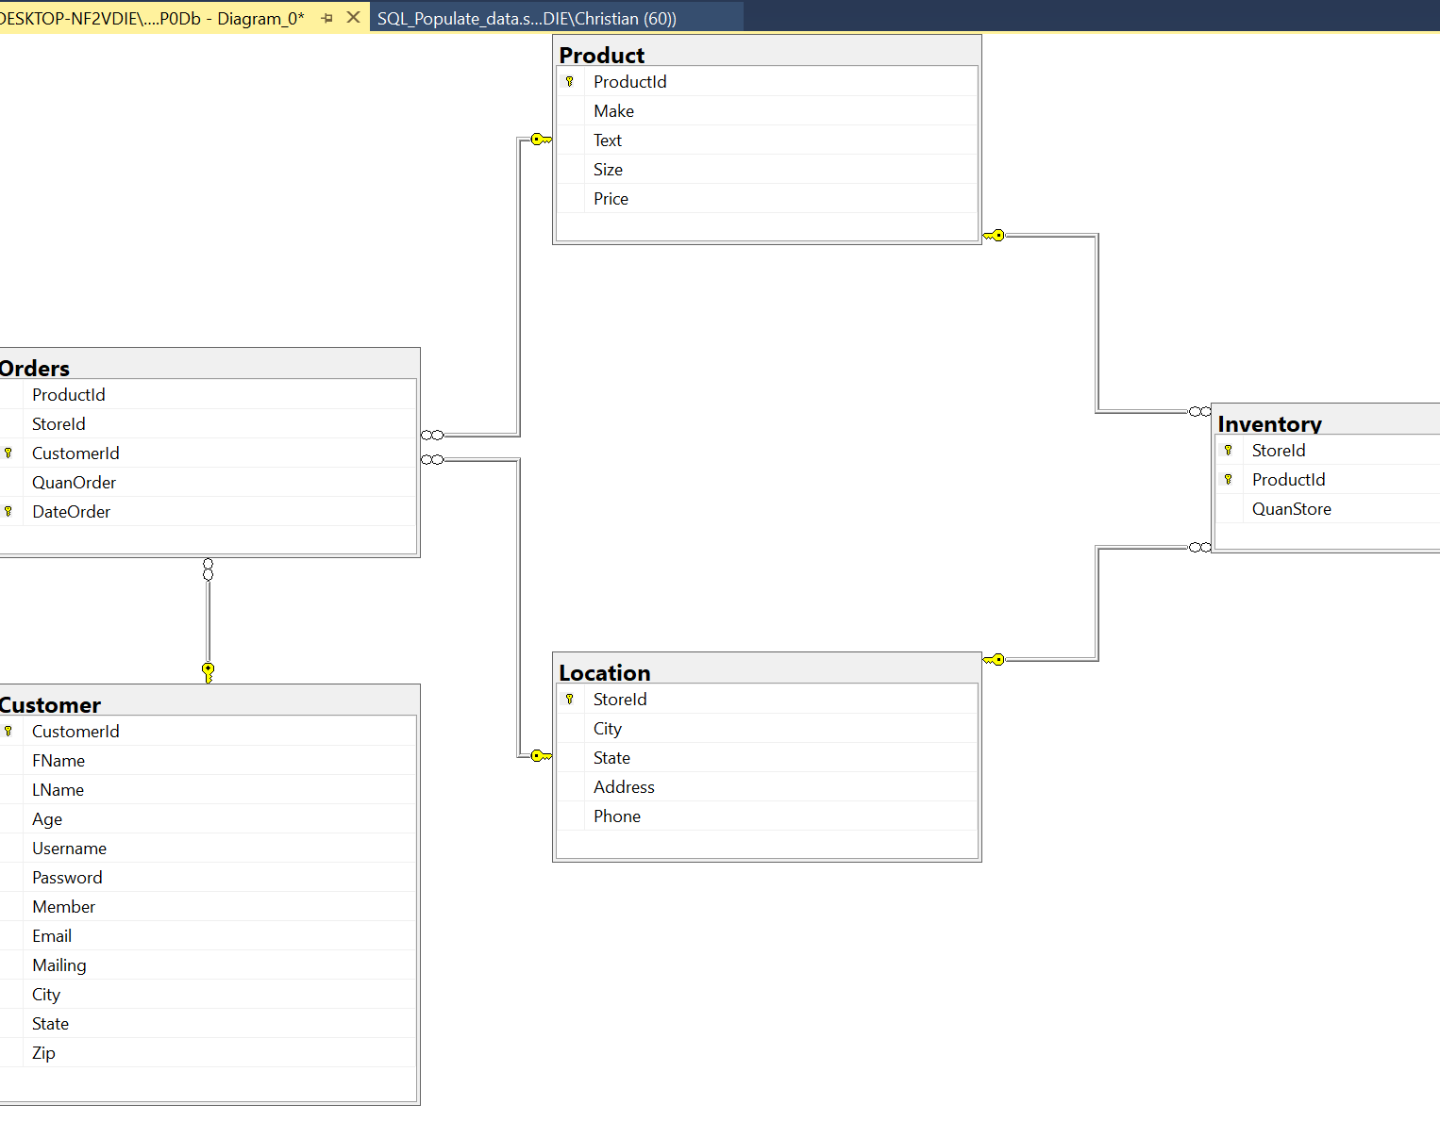
3NF

Slide 4
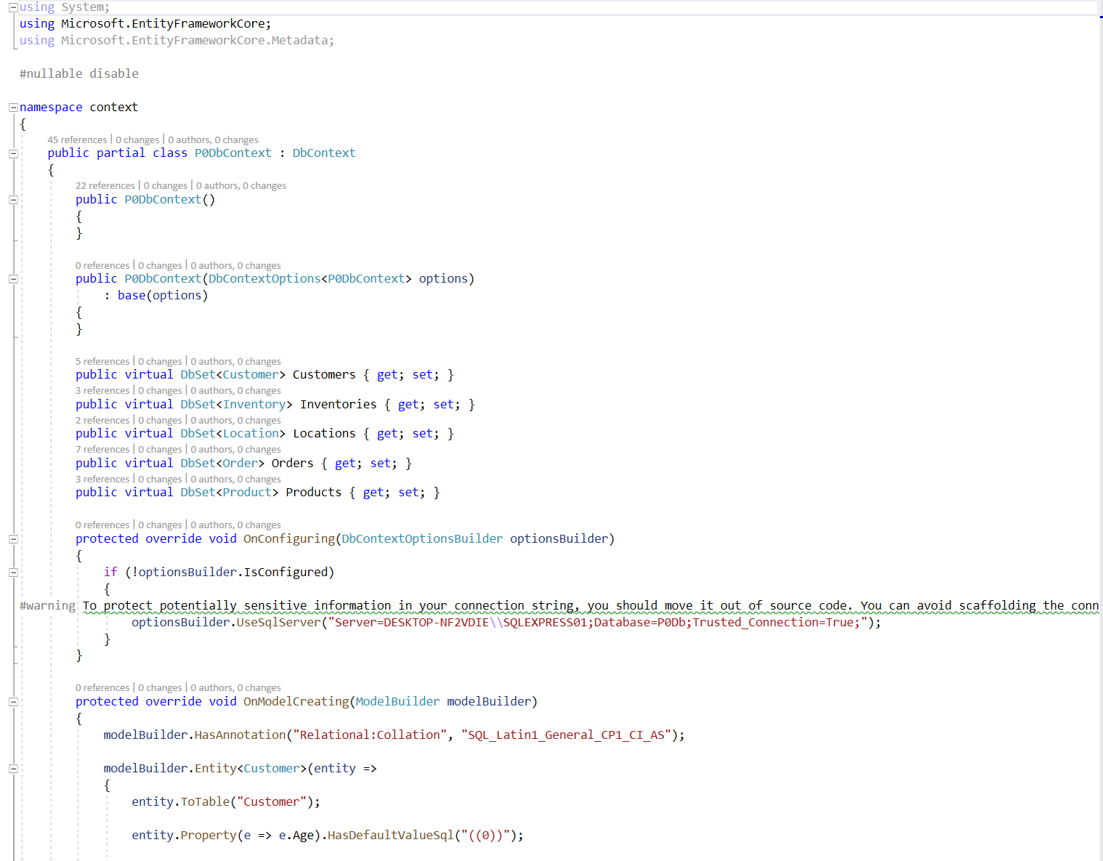
EF Core w/ Db 1st Approach
P0DbContext repo contains full Model builder

Slide 5
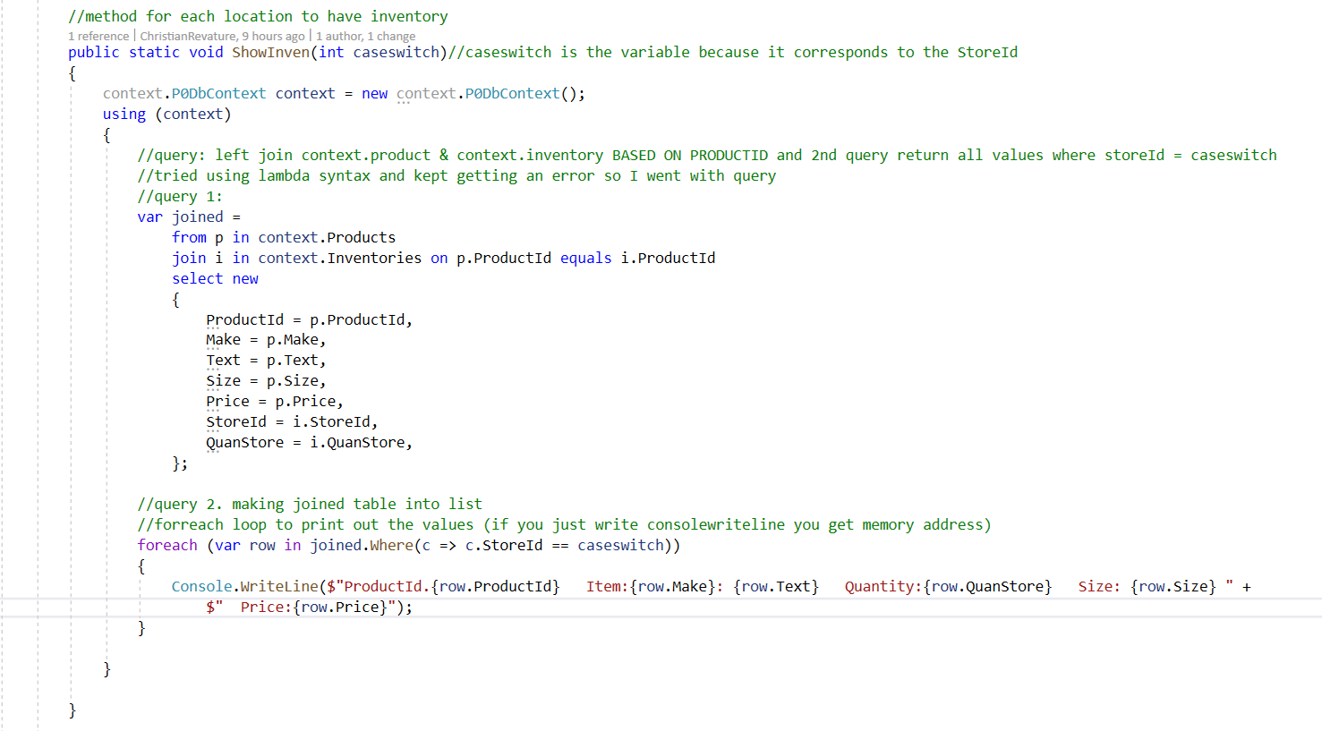
Locations have an inventory

Slide 6
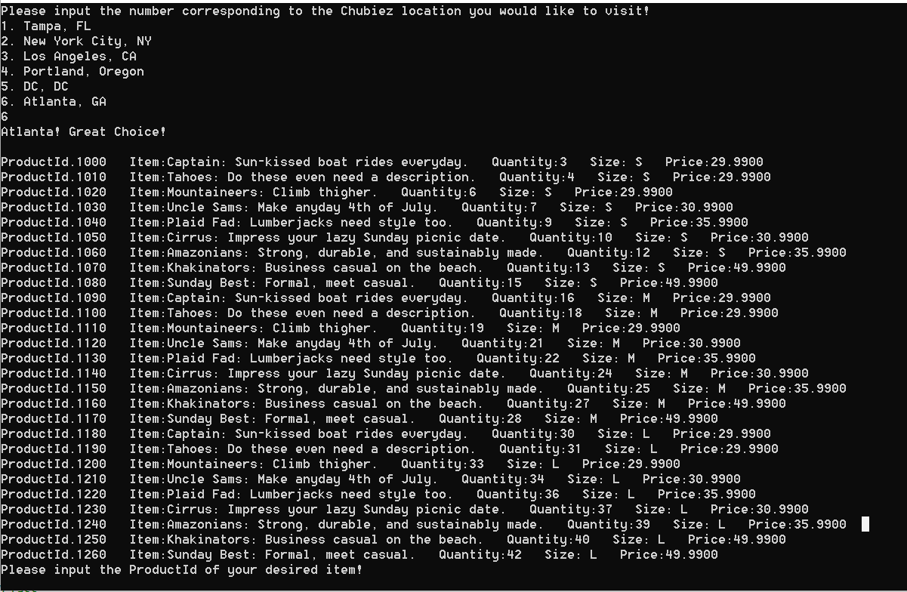
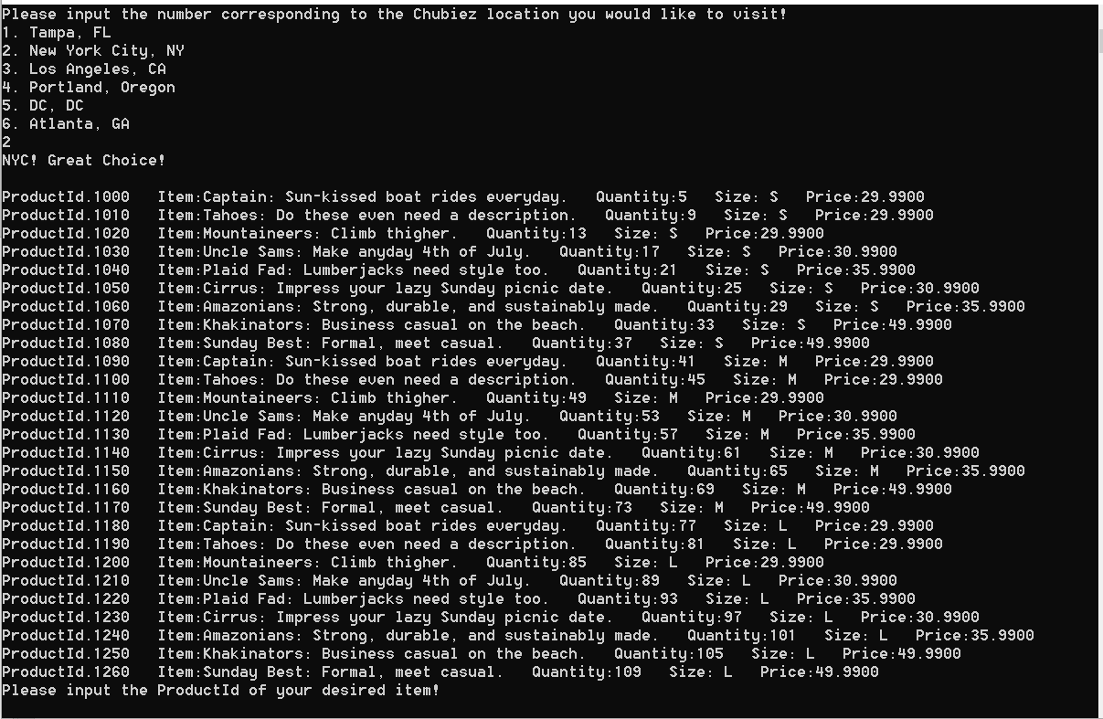
Locations have an inventory

Slide 7
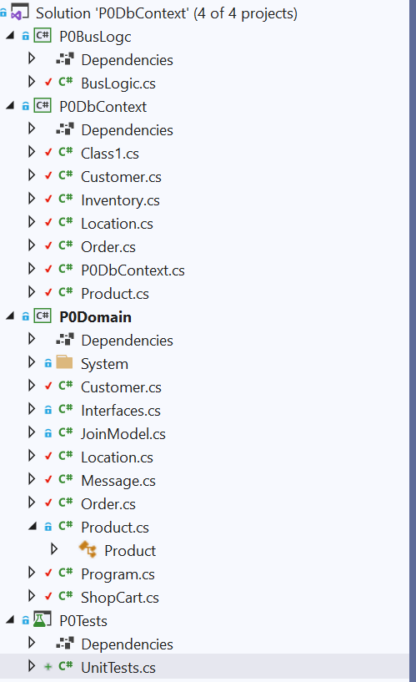
Solution Design

Slide 8
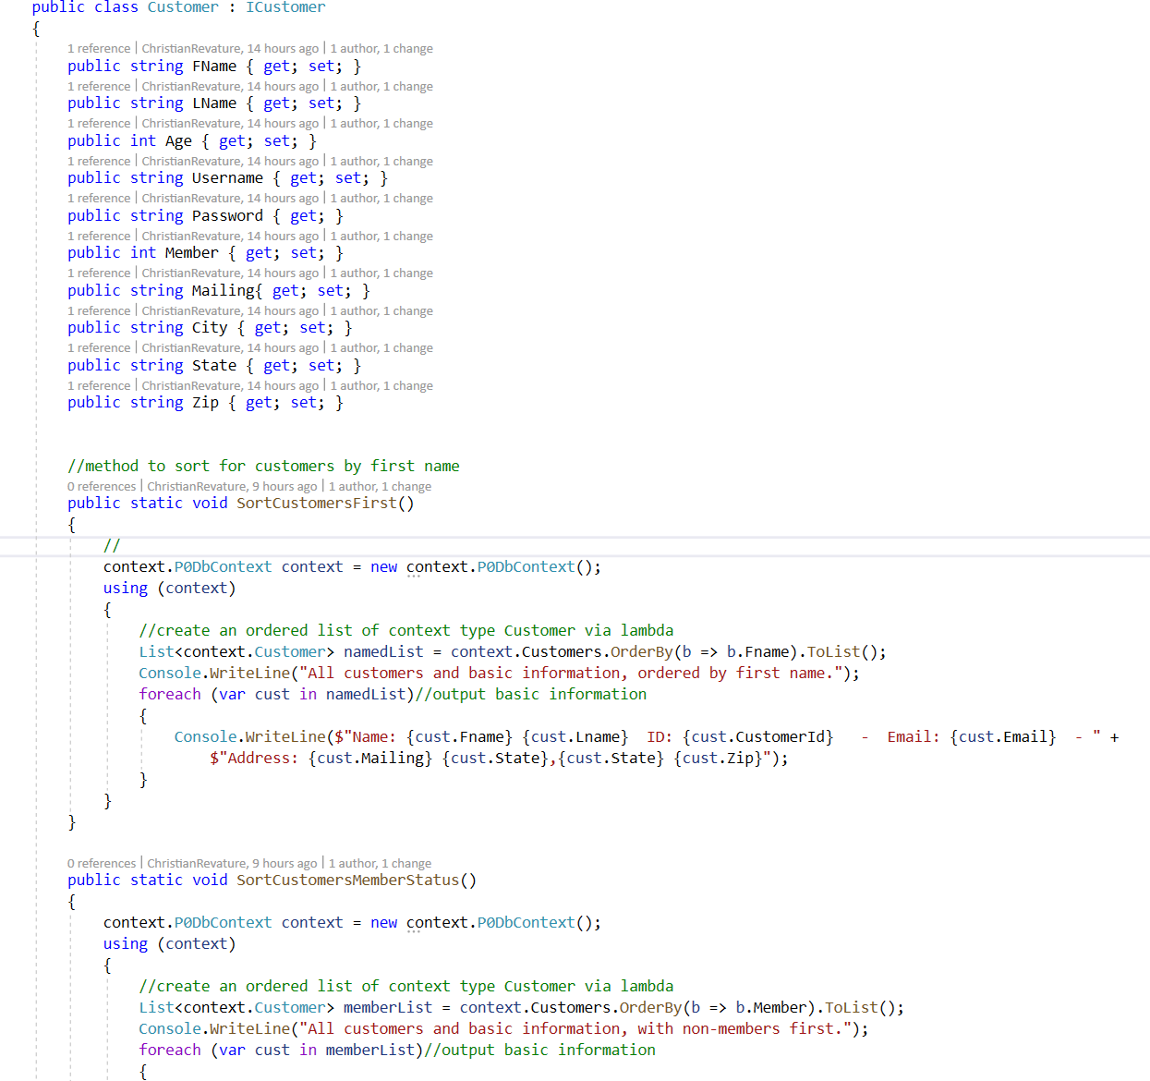
Interfaces

Slide 9
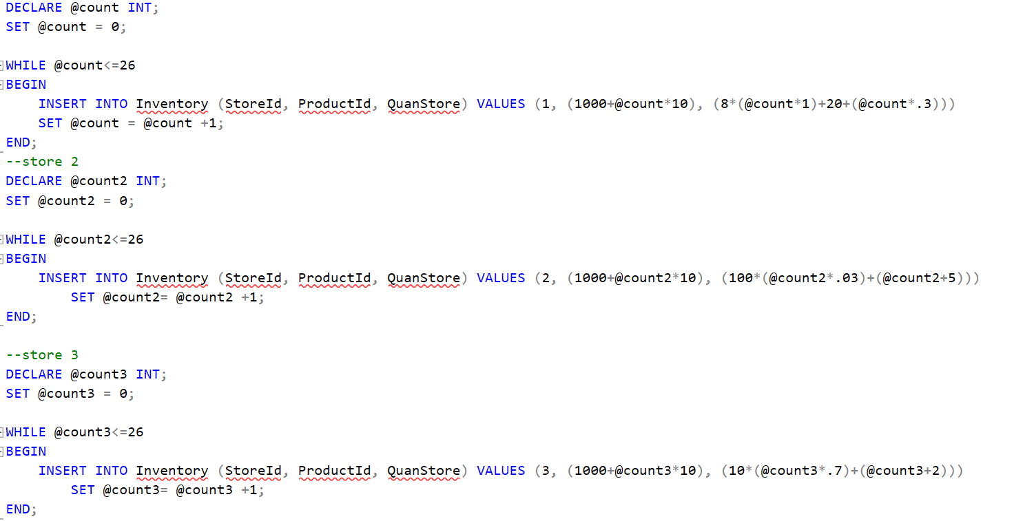
Persistent Data

Slide 10
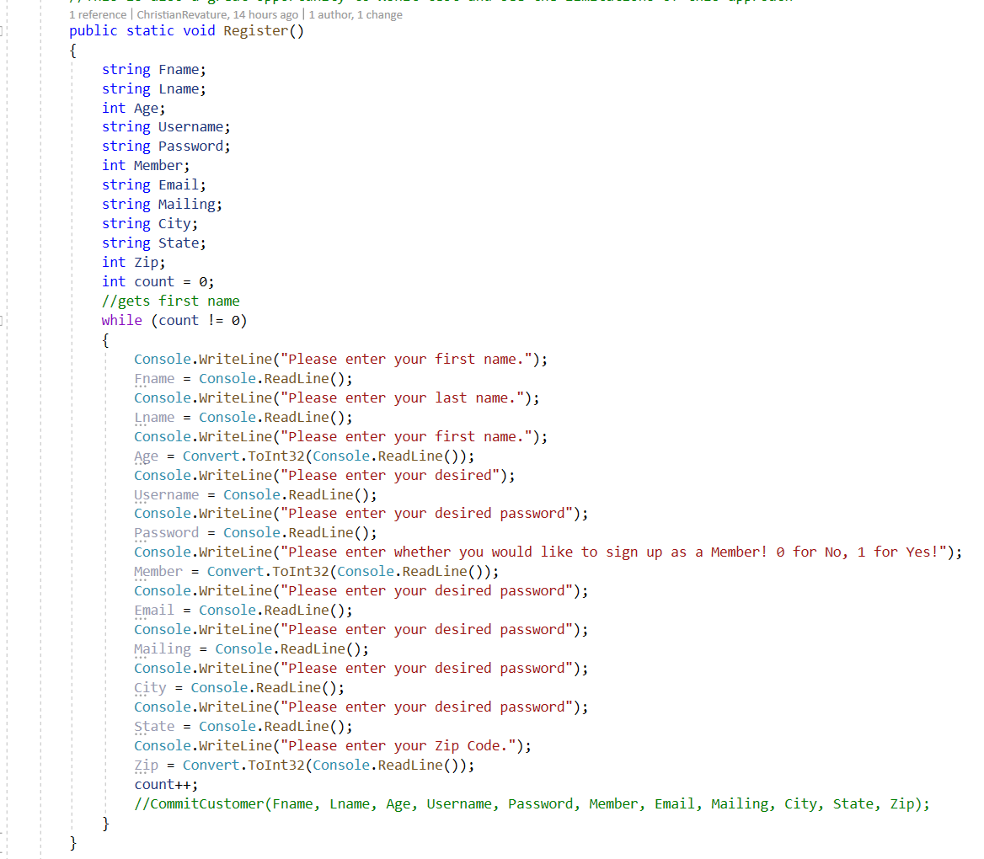
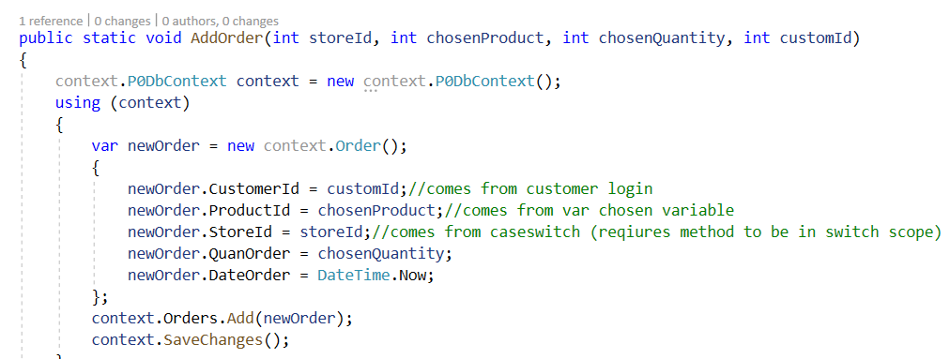
Persistent Data

Slide 11
Functionality
search customers by name
place orders to store locations for customers
display all order history of a customer
add a new customer
display details of an order
input validation
exception handling
display all order history of a store location

Slide 12
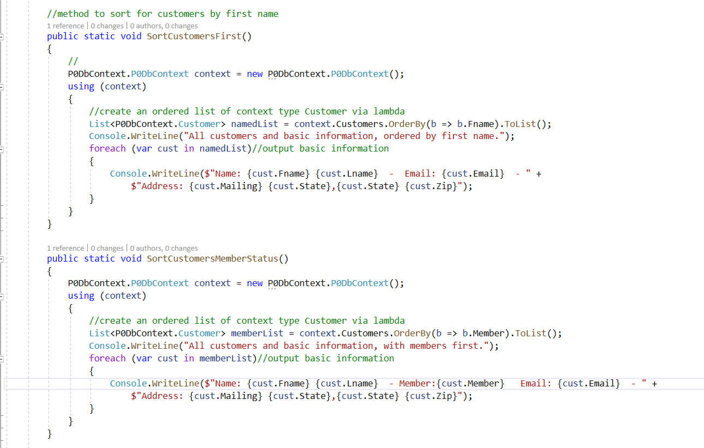
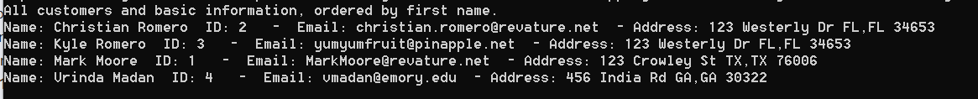
Search customers by name (& other parameters)

Slide 13
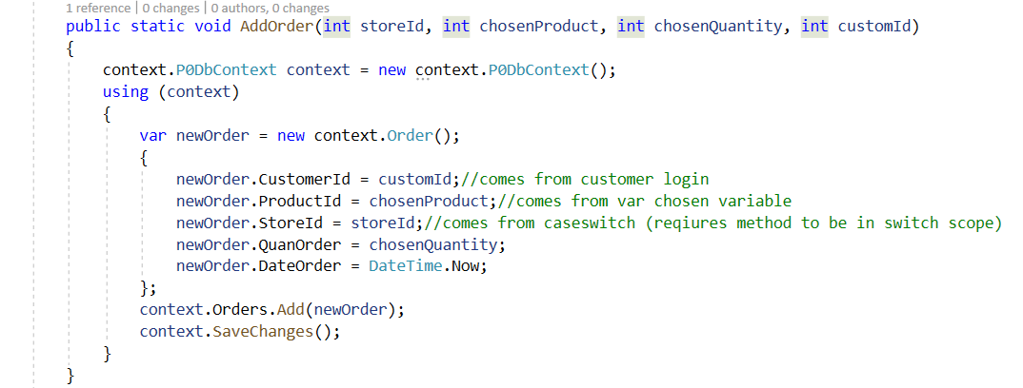
Place orders to store locations for customers

Slide 14
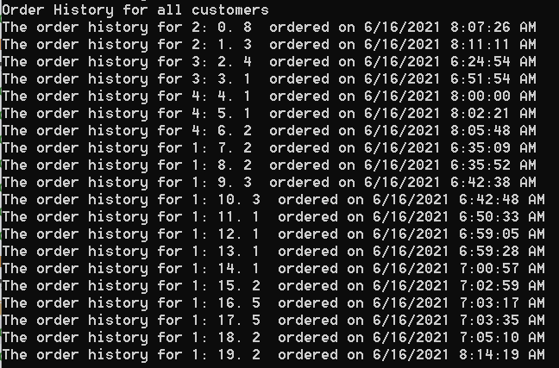
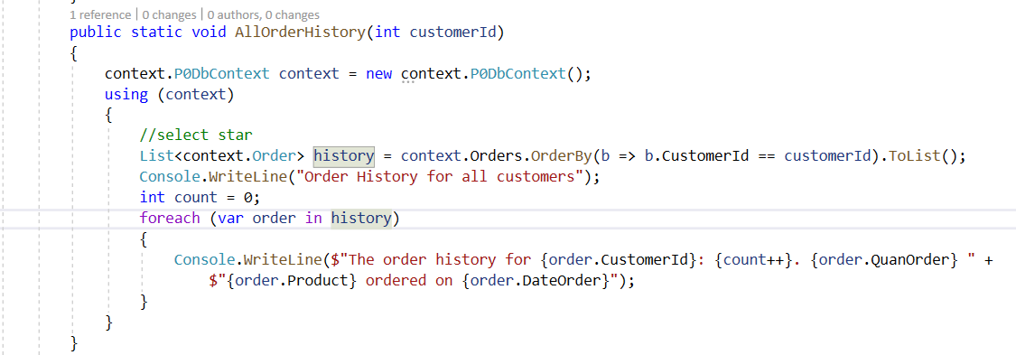
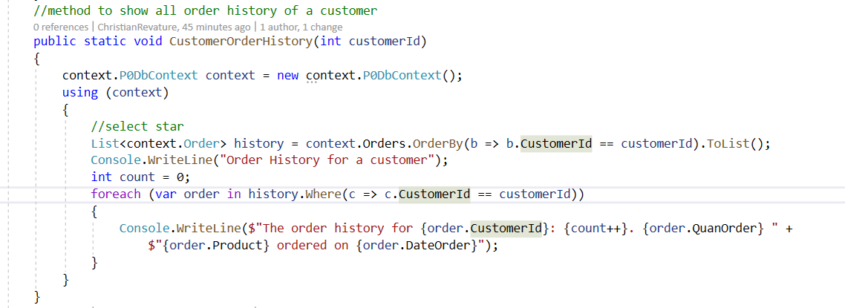
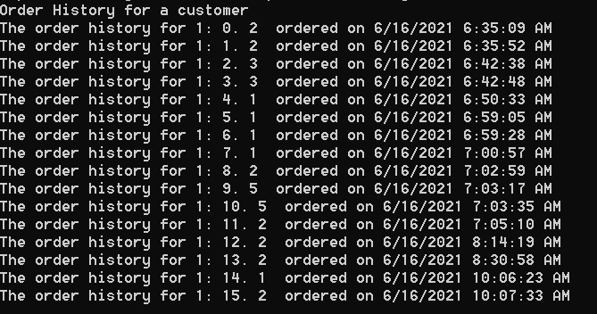
Display all order history of a customer

Slide 15
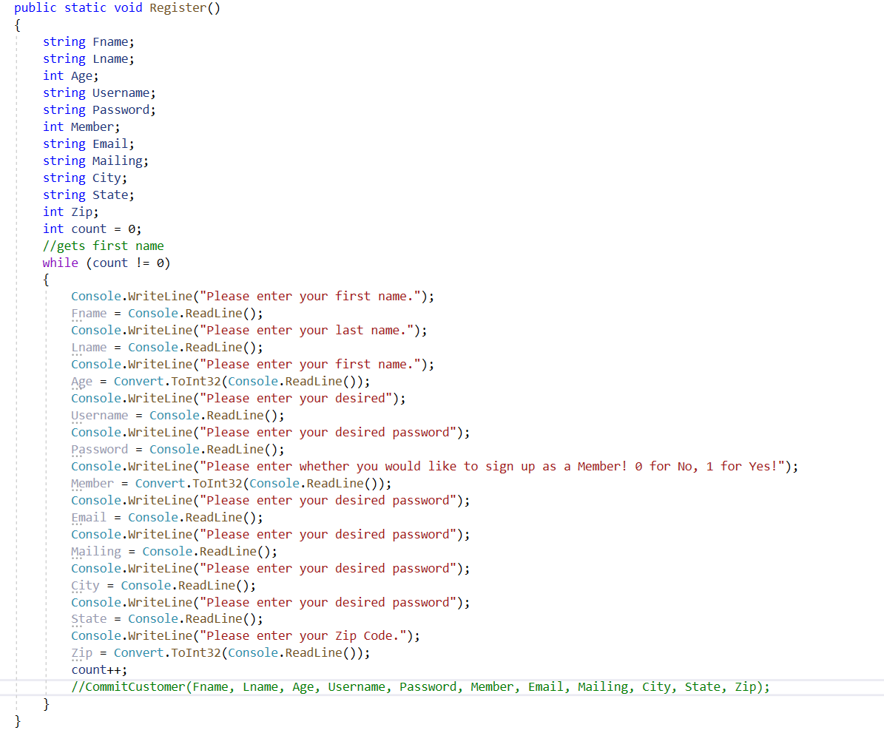
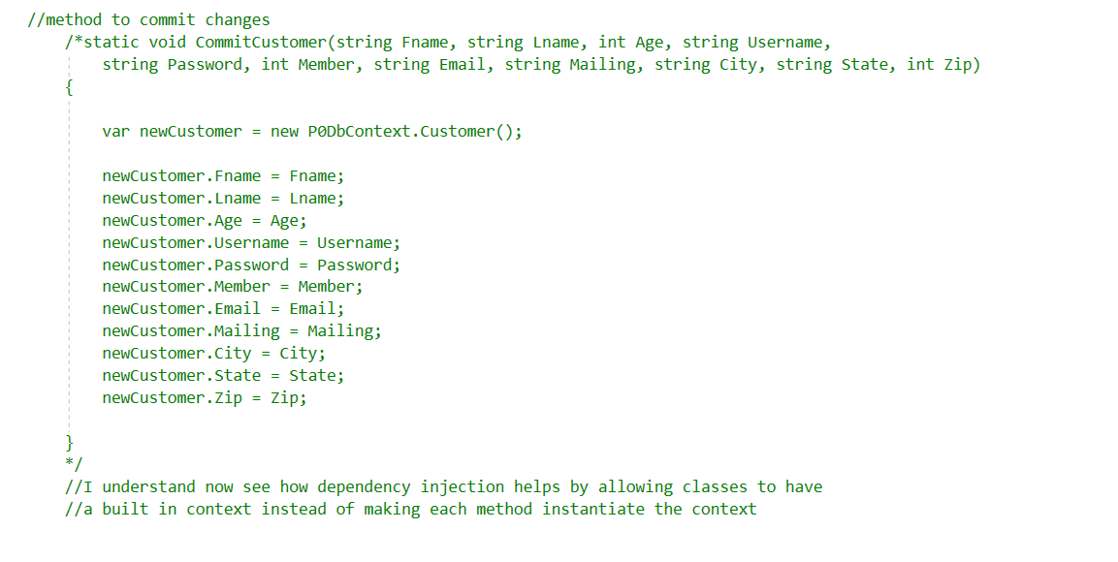
Add a new customer (converted int to bool)

Slide 16
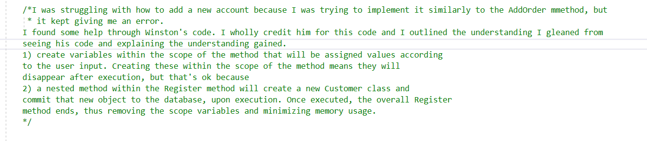
Crediting Winston

Slide 17
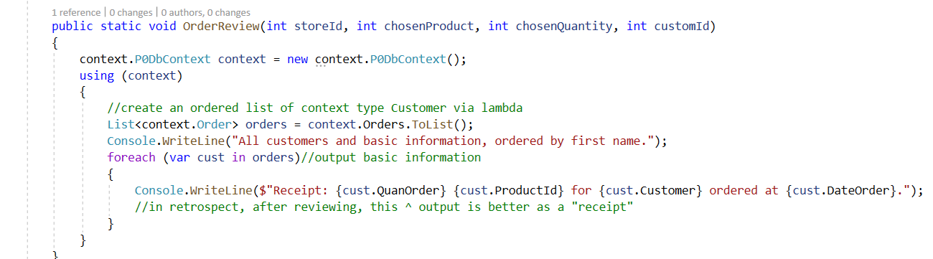
Display details of an order

Slide 18

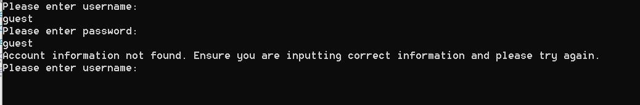
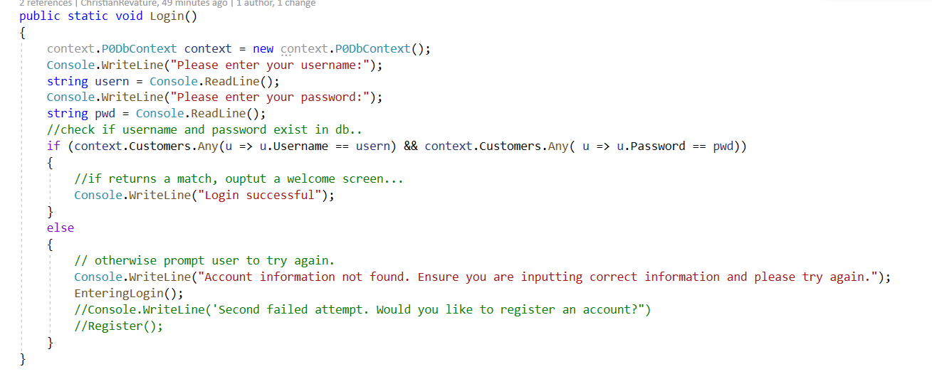
Input Validation

Slide 19
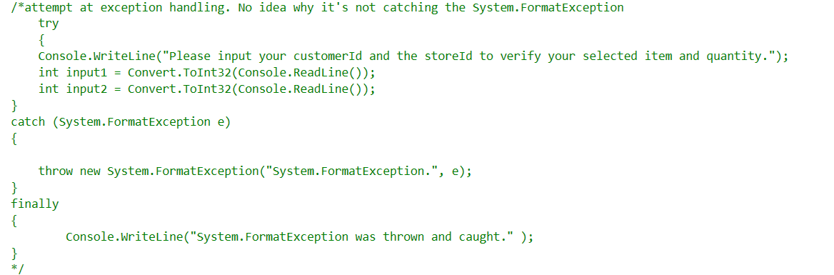
Exception Handling

